Slide 1

A Tourist’s Taste
Analyzing Korean Food Discussions on Reddit's r/KoreanFood
Text Analytics final project | Abdirashid Omar | M2024773

Slide 2
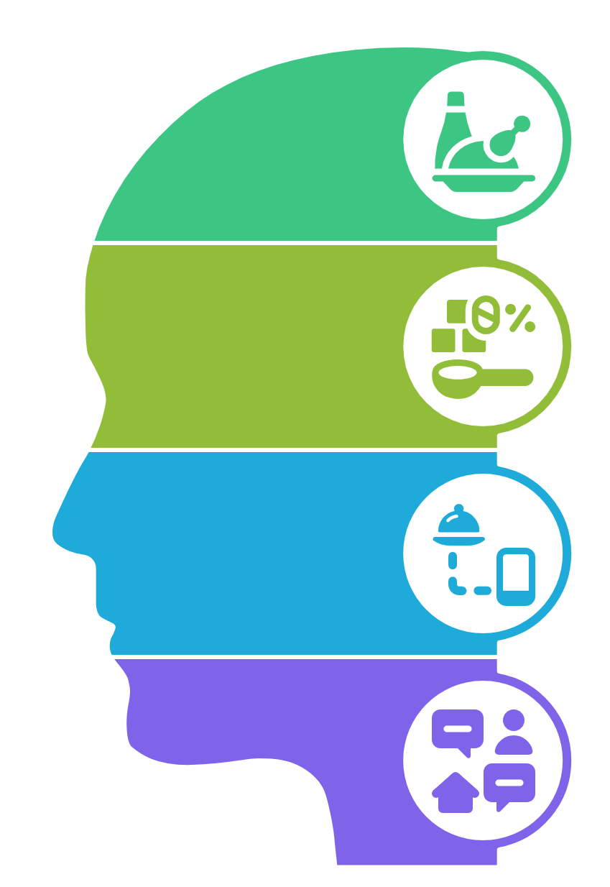
Introduction & Project Goal
Background: Online communities like Reddit are rich sources of user-generated content, offering insights into public opinion and experiences.
Project Goal: To identify the most discussed food items, ingredients, experiences, and common themes related to Korean cuisine as presented on r/KoreanFood.
Focus: This project analyzes discussions on the r/KoreanFood subreddit to understand what users (likely including many tourists or those interested in Korean cuisine) say about Korean food.

Slide 3
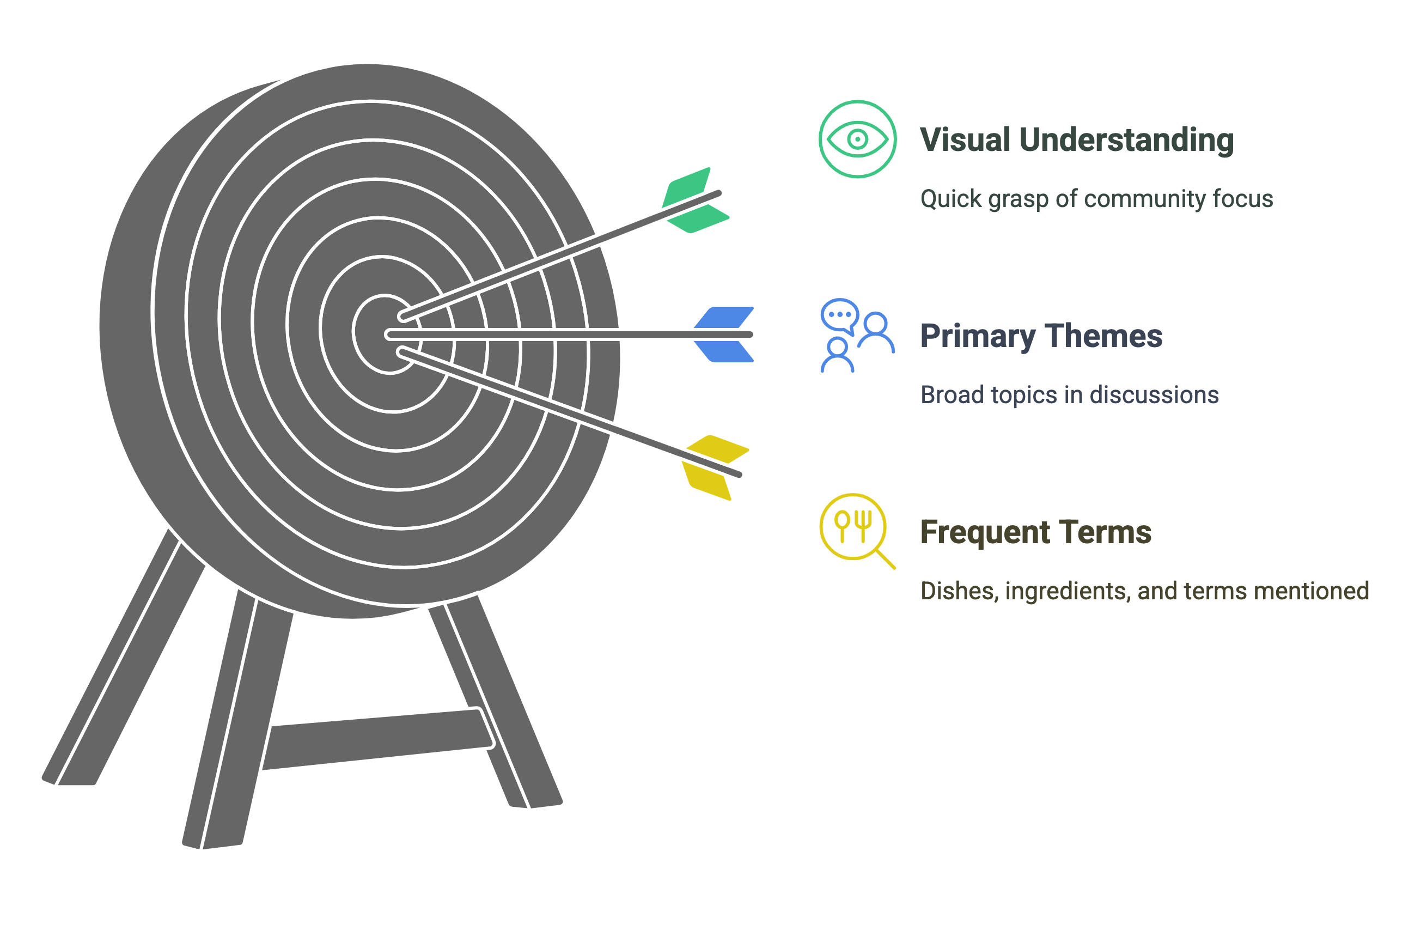
Research Questions?
This project aimed to answer:
What are the most frequently mentioned Korean dishes, ingredients, and food-related terms on r/KoreanFood?
What are the primary themes or topics that emerge from discussions about Korean food on this subreddit?
Can we visualize the most prominent terms to get a quick understanding of the community's focus?

Slide 4
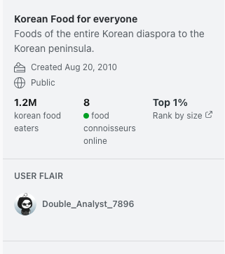

Methodology - Data Collection & Source
Data Source: Reddit, specifically the r/KoreanFood subreddit.
Reasoning: Chosen for its high concentration of discussions specifically about Korean cuisine, ingredients, and recipes, likely attracting both enthusiasts and those seeking information (like tourists). Collection Tool: PRAW (Python Reddit API Wrapper).
Initial Dataset: [500] posts, resulting in [10] rows of text data before cleaning.
Data Scope:
Fetched the top [500] posts from the last year.
Included post titles, self-text, and the top 5 comments for each post to capture a broader range of discussion.

Slide 5
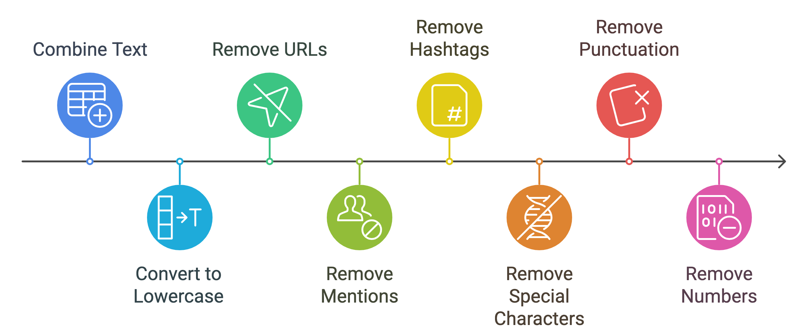
Methodology - Preprocessing
To prepare the text data for analysis, the following steps were taken (using Python and NLTK):
Combined Text: Post titles, self-text, and comments were merged into a single 'full_text' field per post.
2. Cleaning:
Converted text to lowercase.
Removed URLs, @mentions, hashtags, and special characters (like | used as a comment separator).
Removed punctuation and numbers.

Slide 6
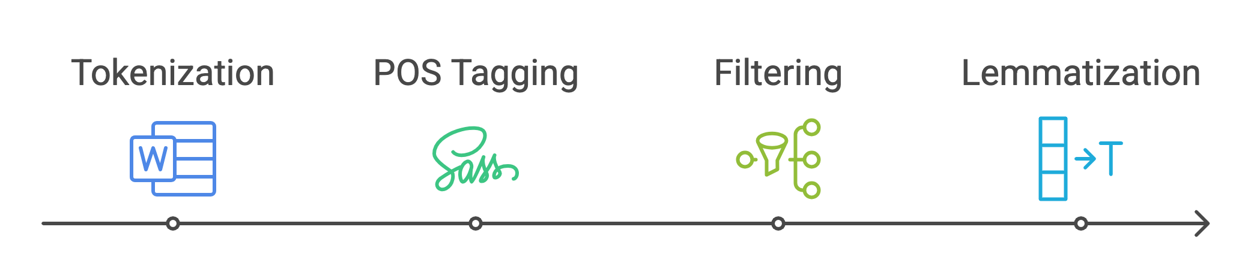
Methodology - Preprocessing
Tokenization: Text was split into individual words (tokens).
Part-of-Speech (POS) Tagging & Filtering: Words were tagged with their grammatical role. Only Nouns (NN) and Adjectives (JJ) were retained, as they often carry the most descriptive meaning.
Lemmatization: Words were reduced to their base or dictionary form (e.g., "eating" -> "eat").

Slide 7
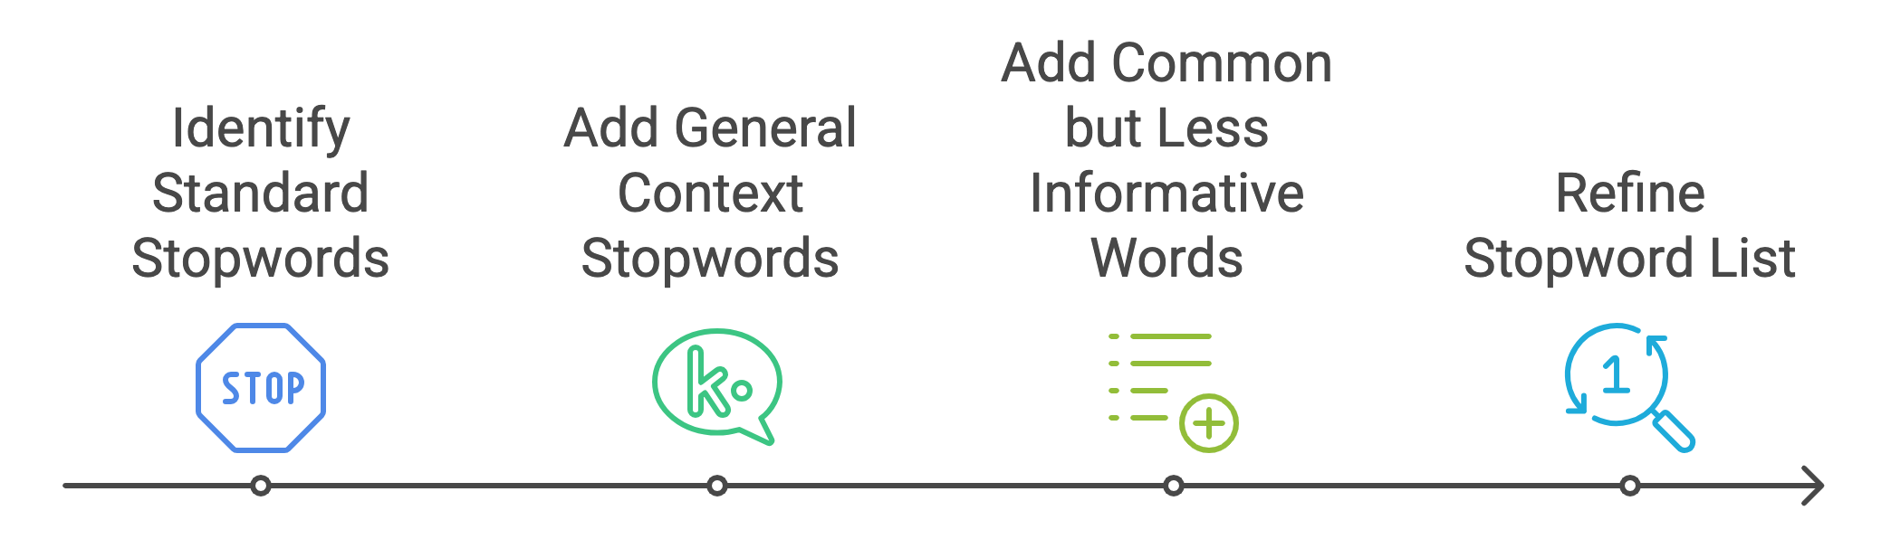
Methodology - Preprocessing
Stopword Removal: Standard English stopwords were removed (e.g., "the", "is", "a").
Custom Stopwords (Crucial Step): Several layers of custom stopwords were iteratively added to remove:
General Reddit/travel/Korea context words (e.g., "korea", "food", "restaurant", "trip", "question", "recommend").
Common but less informative words identified from initial frequency lists (e.g., "station", "hotel", "dish", "favorite", "lol").
This iterative stopword refinement was key to focusing on specific food terms.

Slide 8
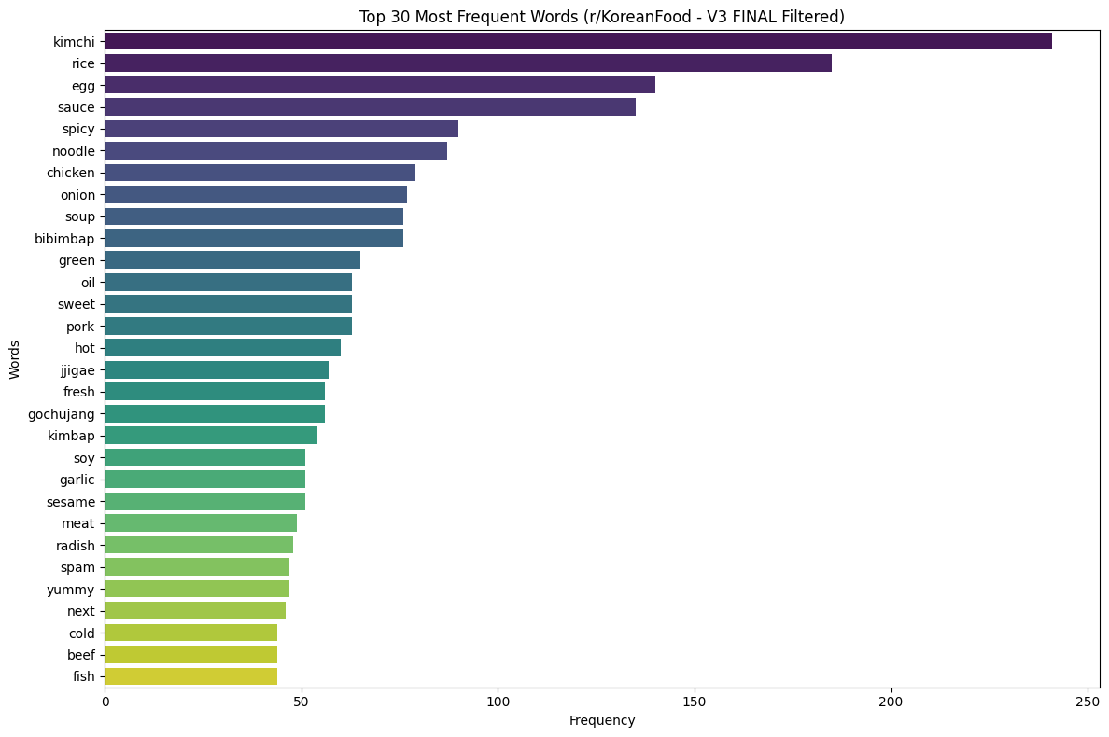
Results - Top Frequent Words
After preprocessing and multiple layers of stopword filtering, the most frequent terms provided a clear focus on specific food items and ingredients.

Slide 9
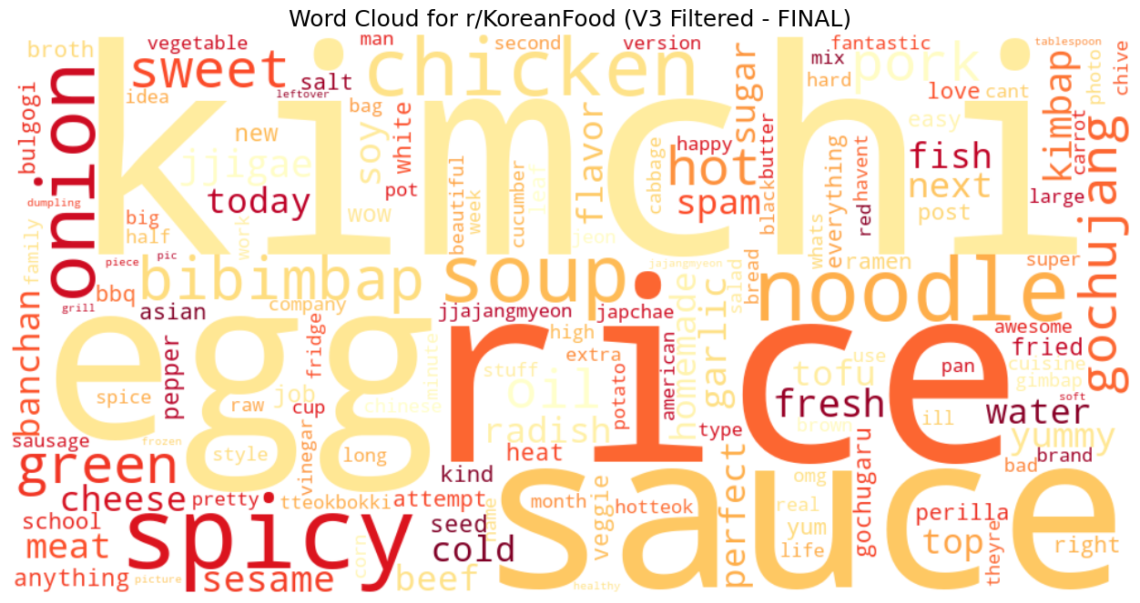
Results - Word Cloud
A word cloud was generated from the final filtered tokens to visually represent the most prominent terms.

Slide 10
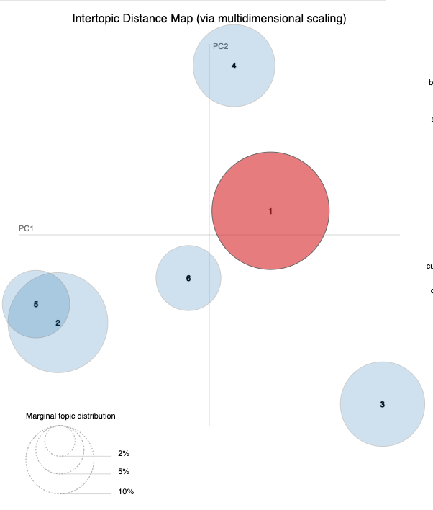
LDA Topic Modeling
Latent Dirichlet Allocation (LDA) was used to identify underlying themes within the r/KoreanFood discussions.
Number of Topics Chosen: 6
Attached As HTML file

Slide 11
Discussion & Insights
The analysis of r/KoreanFood reveals a vibrant community focused on specific dishes, ingredients, and cooking methods.
Unlike broader travel forums, the discussion here is deeply centered on the food itself, with less emphasis on general travel logistics after targeted stopword removal.
Key dishes like Kimchi, Bibimbap, Korean BBQ (chicken, pork), Jjigae, and Kimbap are frequently discussed.
Essential ingredients like gochujang, soy sauce, sesame oil, garlic, and onion are central to many conversations.
Descriptors like "spicy," "sweet," and "hot" are commonly used, highlighting taste profiles.
The topics identified by LDA provide a structured view of the main conversational clusters, ranging from specific dish types to core ingredients and cooking discussions.

Slide 12
Challenges & Limitations
Initial Data Focus: Early attempts using broader subreddits (r/koreatravel) or general news sources yielded less specific food-related terms, requiring a pivot to r/KoreanFood.
Iterative Stopword Refinement: Achieving a clear focus on specific food items required multiple iterations of adding custom stopwords based on observed frequency lists.
Reddit Slang/Informality: The informal nature of Reddit text (e.g., "lol", "youre") can sometimes appear in initial analyses if not aggressively filtered.
Sentiment Analysis (Not Performed in Detail): While basic sentiment could be inferred, a dedicated sentiment analysis was not the primary focus of this iteration but could be future work.
Limited Scope: Analysis is based on a snapshot of 'top' posts from one year and may not capture all nuances or long-term trends.

Slide 13
Conclusion
This project successfully identified the key food items, ingredients, and discussion themes within the r/KoreanFood subreddit.
By focusing the data source and iteratively refining preprocessing (especially stopwords), it was possible to extract clear and specific insights directly related to Korean cuisine.
The results demonstrate that r/KoreanFood is a rich resource for understanding popular Korean dishes and the community's engagement with them.
The dominant terms and topics revolve around iconic dishes like Kimchi, BBQ, and Bibimbap, essential ingredients like gochujang, and the experience of preparing and enjoying these foods.

